Slide 1
DIABETIS PREDICTION USING LOGISTIC REGRESSION

Slide 2
TOOLS USED FOR DOING THE PROJECT :
R LANGUAGE

Slide 3
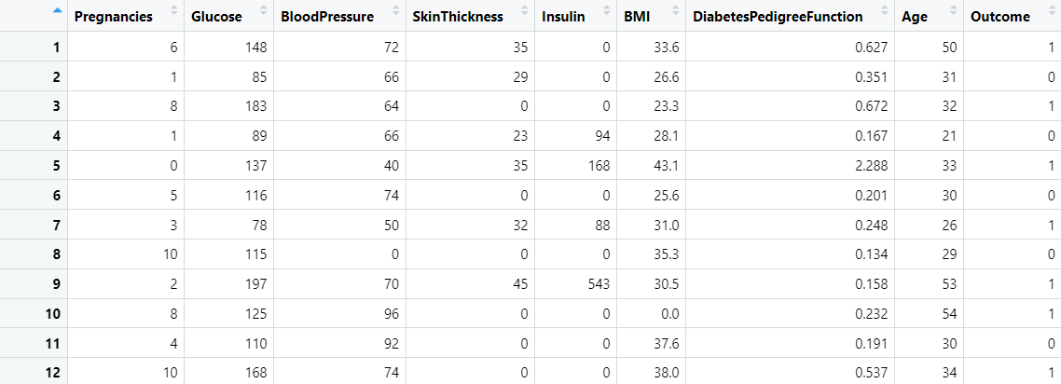
FIRST 12 ROWS OF OUR DIABETES DATASET

Slide 4
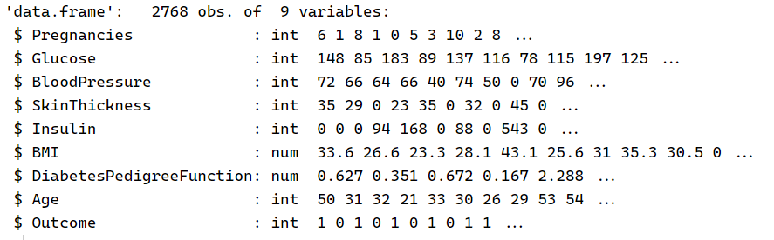
STRUCTURE OF THE DATA FRAME

Slide 5
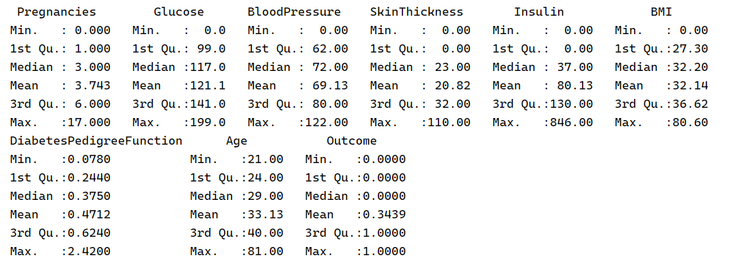
SUMMARY OF THE DATA :

Slide 6
DATA DESCRIPTION
VARIABLE | DESCRIPTION
Pregnancies | To express the number of pregnancies
Glucose | To express the Glucose level in blood (mg/dL)
BloodPressure | To express the Blood pressure measurement (mmHg)
SkinThickness | To express the thickness of the skin (mm)
Insulin | To express the Insulin level in blood (µU/mL – micro-units per milliliter)
BMI | To express the Body mass index (kg/m²)
DiabetesPedigreeFunction | Genetic risk score that quantifies the likelihood of diabetes based on family history. It ranges from 0 to 2.5+. It is unitless .
Age | To express the age ( in years)
Outcome | To express the final result 1 is Yes and 0 is No

Slide 7
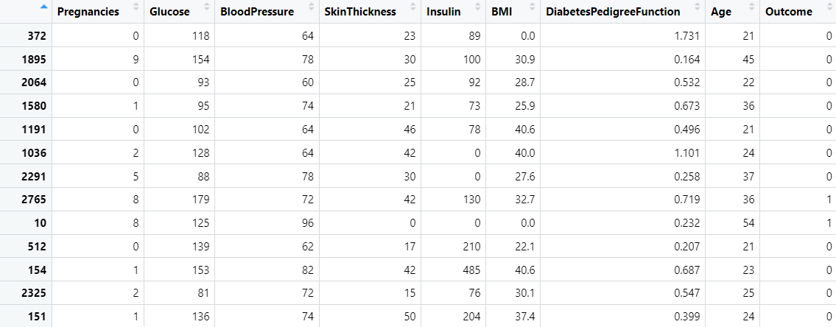
We will do the train-test split of the data in the ratio 80:20 ( 2214 rows are selected randomly without replacement for training) . The first few rows of the training data is shown below .

Slide 8
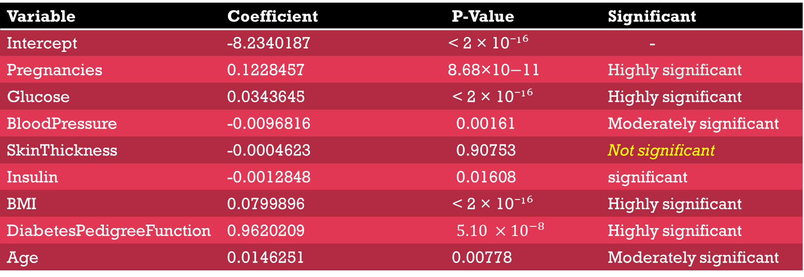
Now , we apply Logistic Regression in R , and get the following result :
Variable | Coefficient | P-Value | Significant
Intercept | -8.2340187 | < 2 × 10⁻¹⁶ | -
Pregnancies | 0.1228457 | 8.68×10−11 | Highly significant
Glucose | 0.0343645 | < 2 × 10⁻¹⁶ | Highly significant
BloodPressure | -0.0096816 | 0.00161 | Moderately significant
SkinThickness | -0.0004623 | 0.90753 | Not significant
Insulin | -0.0012848 | 0.01608 | significant
BMI | 0.0799896 | < 2 × 10⁻¹⁶ | Highly significant
DiabetesPedigreeFunction | 0.9620209 | $${5.10 ×10}^{−8}$$ | Highly significant
Age | 0.0146251 | 0.00778 | Moderately significant

Slide 9
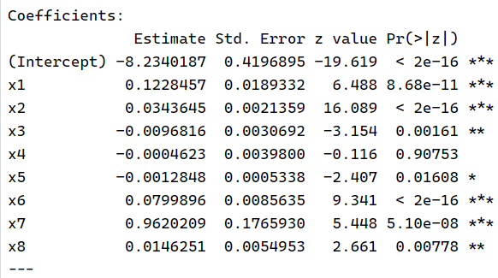



Now we will predict the probability of the chances of occurrence of diabetes and obtaining the AIC values
based on first model .
$$π_{i}=P\left(Y_{i}=1 \right| X_{i})=probability of occurence of diabetes gixen X$$
Logistic Regression Model : $$\log\left(\frac{π}{1−π}\right)=β_{0}+β_{1}x_{1}+β_{2}x_{2}+ ……+β_{8}x_{8}$$
Fitted Probability : $$π_{i}= \frac{exp⁡(β_{0}+β_{1}x_{1}+β_{2}x_{2}+…+β_{8}x_{8})}{1+exp⁡(β_{0}+β_{1}x_{1}+β_{2}x_{2}+⋯⋯+β_{8}x_{8})}$$
Below are the first 5 fitted probability value
AKAIKE INFORMATION CRITERION ( to check the goodness of fit and model complexity )
$$AIC=−2 \sum{\left[y_{i}\log\left(π_{i}\right)+\left(1−y_{i}\right)\log\left(1−π_{i}\right)\right]}+2K$$
Where K is the no. of parameter including intercept
AIC value of the first model is 2124.301

Slide 10
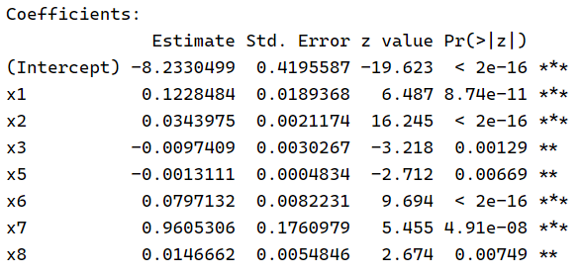
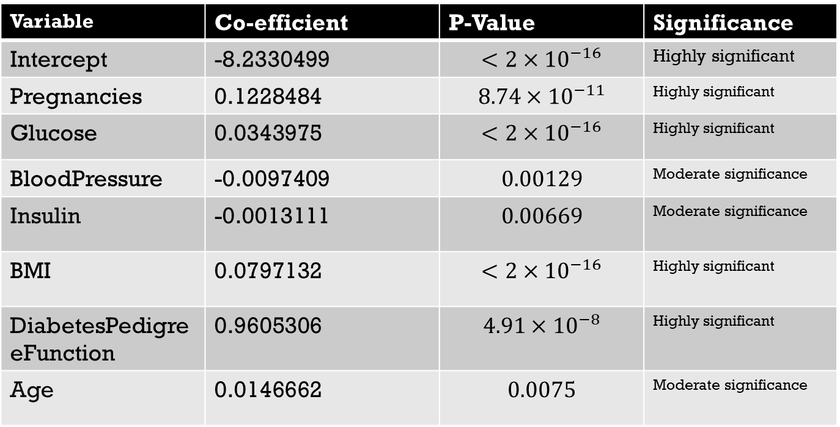
Feature selection for the next iteration :
Skin Thickness is found to be less significant . So, we will remove that variable and
compute Logistic Regression . And we get the result as below
Variable | Co-efficient | P-Value | Significance
Intercept | -8.2330499 | $$<2×{10}^{−16}$$ | Highly significant
Pregnancies | 0.1228484 | $$8.74×{10}^{−11}$$ | Highly significant
Glucose | 0.0343975 | $$<2×{10}^{−16}$$ | Highly significant
BloodPressure | -0.0097409 | $$0.00129$$ | Moderate significance
Insulin | -0.0013111 | $$0.00669$$ | Moderate significance
BMI | 0.0797132 | $$<2×{10}^{−16}$$ | Highly significant
DiabetesPedigreeFunction | 0.9605306 | $$4.91×{10}^{−8}$$ | Highly significant
Age | 0.0146662 | $$0.0075$$ | Moderate significance
Age has higher p-value so it will be considered as the least significant variable .

Slide 11

AIC value of the $2^{nd}$ model :
We obtain the predicted probability for this model . And we get the the result as below
These are the first 6 predicted probability obtained in the similar way ,
as we did it for the first model.
In this model , AIC values is decreased from the previous model, and this iteration will continue until AIC is increased from the previous one .
And the AIC value is 2122.314

Slide 12
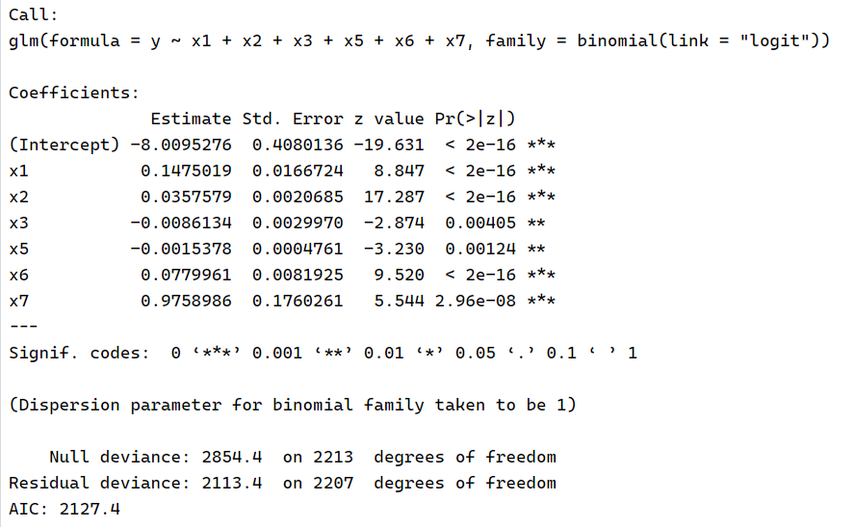
Doing feature selection for the $3^{rd}$ iteration and apply Logistic Regression .
Now , in this case we will eliminate the feature ‘Age’ from the $2^{nd}$ model and apply GLM
under ‘logit’ link .

Slide 13



OBSERVATIONS AS OBTAINED FROM THE $3^{rd}$MODEL :
All the variable used are significant as all the p-value are less than 0.05 . Among all the
significant variable , ‘Glucose ($x_{3}$)’ is found to be less significant as its p-value is highest
among all the p-value of other variable .
This time , the AIC value is increased from the previous one . So , we will stop iteration here and consider $2^{nd}$model as the best model .
AIC value of $3^{rd}$ model is 2127.4

Slide 14
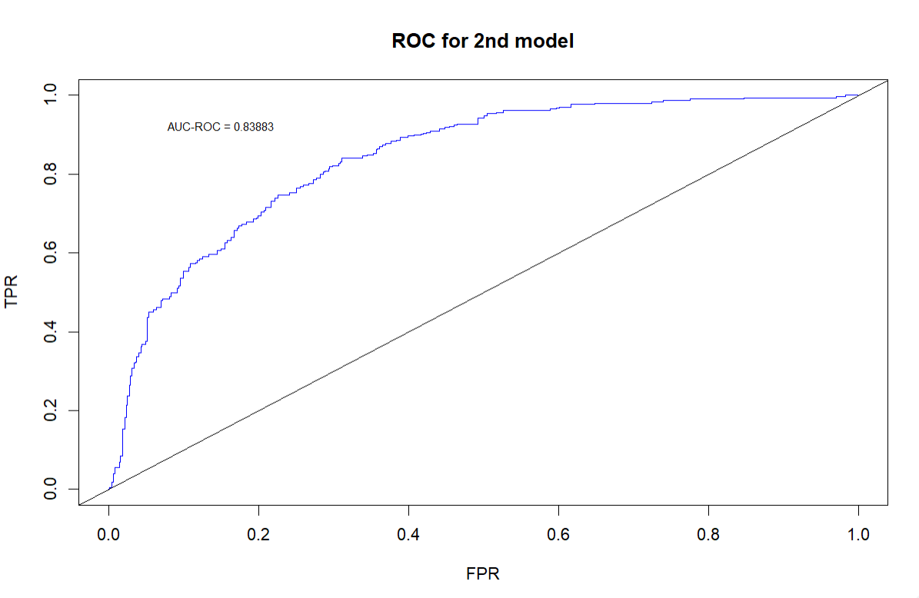
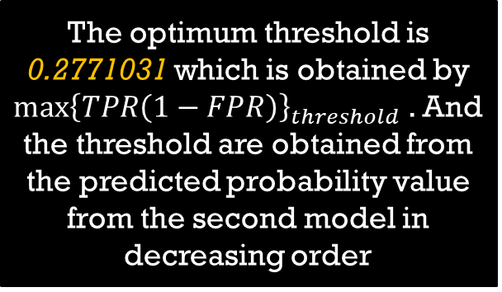
OBTAINING ROC MODEL AND THEIR CORRESPONDING AUC VALUES BASED ON $2^{nd}$ MODEL
AUC is obtained to be 0.83883 , which implies second model has good discrimination power and less chances of overfitting .
The optimum threshold is 0.2771031 which is obtained by
${\max\left\{TPR\left(1−FPR\right)\right\}}_{threshold}$ . And
the threshold are obtained from
the predicted probability value
from the second model in decreasing order

Slide 15
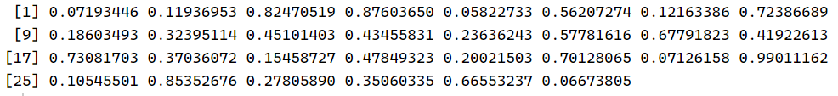
Now we will apply second model on the testing data set and obtain the predicted probabilities
of the occurrence of diabetes .
Below are given the first 30 values of the predicted probabilities on forecast data , based
On second model .
The prediction of output will be if predicted probability greater than optimum threshold , then
Diabetes is present , otherwise absent .

Slide 16
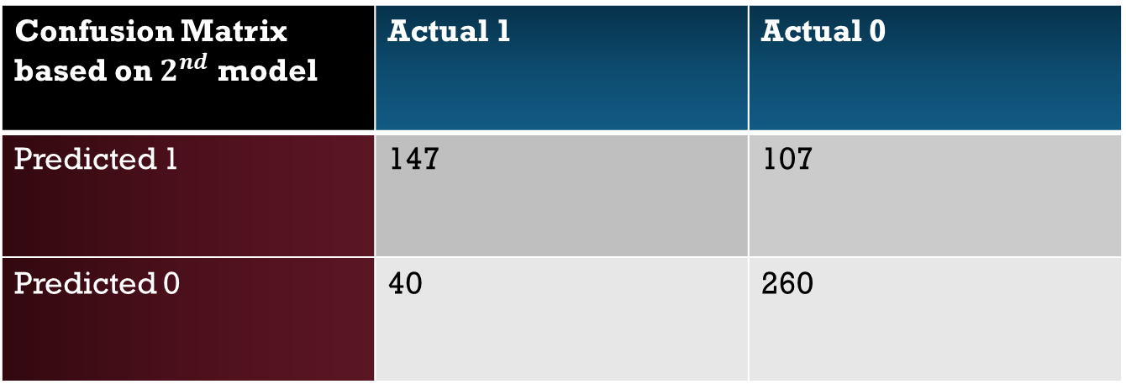
Confusion Matrix based on $2^{nd}$ model | Actual 1 | Actual 0
Predicted 1 | 147 | 107
Predicted 0 | 40 | 260
True Positive Rate = $\frac{TP}{TP+FN}$ = $\frac{147}{147+40}$ = 0.78610 , implies strong detection of presence of diabetes
Specificity = $\frac{TN}{FP+TN}$ = $\frac{260}{107+260}=0.70844$ , implies moderate detection of absence of diabetes
Accuracy = $\frac{147+260}{554}= \frac{407}{554}=0.73465$ , implies model have a good accuracy of predicting original
outcome .
Overall , model is performing well and have a good balance between specificity(TNR) and sensitivity(TPR) .

